Slide 1
Department of Computer Science
CS F364 – DESIGN AND ANALYSIS OF ALGORITHMS
LECTURE –BACKTRACKING – N QUEENS PROBLEM
PORTIONS: As specified in handout and the contents taught in class. Class notes is must. Refer to the textbook as mentioned in handout
PLEASE NOTE THAT PPT IS JUST AN ADDITIONAL REFERENCE.

Slide 2
Topic- Backtracking
N-Queens

Slide 3
Backtracking
Backtracking is a general algorithm for finding all (or some) solutions to some computational problem, that incrementally builds candidates to the solutions, and abandons each partial candidate ‘c’ ("backtracks") as soon as it determines that ‘c’ cannot possibly be completed to a valid solution.
Backtracking is an important tool for solving constraint satisfaction problems, such as crosswords, verbal arithmetic, Sudoku, and many other puzzles.

Slide 4
Terminology
Problem state is each node in the depth-first search tree
State space is the set of all paths from root node to other nodes
Solution states are the problem states s for which the path from the root node to s defines a tuple in the solution space
– In variable tuple size formulation tree, all nodes are solution states
– In fixed tuple size formulation tree, only the leaf nodes are solution states
– Partitioned into disjoint sub-solution spaces at each internal node
Answer states are those solution states s for which the path from root node to s defines a tuple that is a member of the set of solutions
– These states satisfy implicit constraints

Slide 5
Terminology
State space tree is the tree organization of the solution space
Static trees are ones for which tree organizations are independent of the problem instance being solved
– Fixed tuple size formulation
– Tree organization is independent of the problem instance being solved
Dynamic trees are ones for which organization is dependent on problem instance
– After conceiving state space tree for any problem, the problem can be solved by systematically generating problem states, checking which of them are solution states, and checking which solution states are answer states

Slide 6
Terminology
Live node is a generated node for which all of the children have not been generated yet
E-node is a live node whose children are currently being generated or explored
Dead node is a generated node that is not to be expanded any further
– All the children of a dead node are already generated
– Live nodes are killed using a bounding function to make them dead nodes

Slide 7
Backtracking Tree Structure
Start
Success!
Success!
Failure
Problem space consists of states (nodes) and actions (paths that lead to new states).
If a node only leads to failure, it will go back to its "parent“ node and will try for another alternative. If these all lead to failure then further backtracking may be necessary.

Slide 8
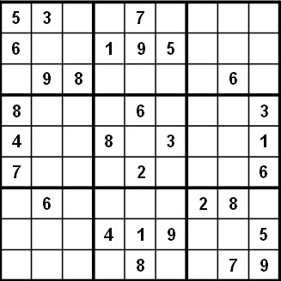
A More Concrete Example
Sudoku
9 by 9 matrix
Fill in all numbers between 1 and 9
Goal: Each row, each column, and each mini matrix must contain the numbers between 1 and 9 once each
No duplicates in rows, columns, or mini matrices

Slide 9

Solving Sudoku – Brute Force
A brute force algorithm is a simple but general approach
Try all combinations until you find the right ones. This approach isn’t clever.
Brute force algorithms are slow. They don't employ logic
For example we know 6 can't go in the last 3 columns of the first row, but the brute force algorithm will plow ahead any way
But, brute force algorithms are fairly easy to implement but leads to exponential time complexity.
Backtracking algorithm introduced bounding functions to reduce the iterations. Most of the back tracking algorithms are recursive in nature.

Slide 10
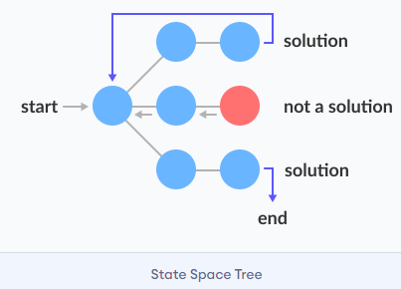
Recursive Backtracking
Problems such as Suduko can be solved using recursive backtracking.
Pseudo code for recursive backtracking algorithms
Backtrack(x)
if x is not a solution
return false
if x is a new solution
add to list of solutions
backtrack(expand x)

Slide 11
Recursive Backtracking
Possible goals of backtracking
Find a path to success
Find all paths to success
Find the best path to success
Not all problems are exactly alike, and finding one success node may not be the end of the search
Start
Success!
Success!

Slide 12

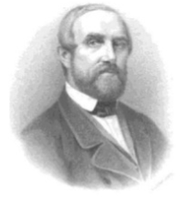

N Queens Problem
The puzzle was originally proposed in 1848 by the chess player Max Bezzel and over the years many mathematicians, including Gauss, have worked on this puzzle.
The first solution for 8 queens were provided by Franz Nauck in 1850. Nauck also extended the puzzle to n-queens problem (on an n by n – a chessboard of arbitrary size ).

Slide 13
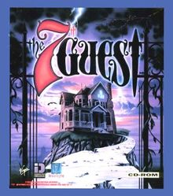
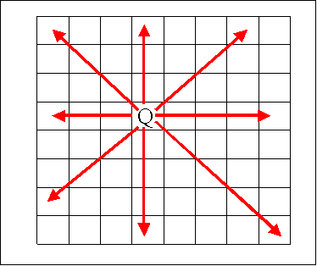
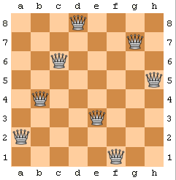
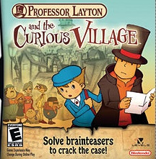
The N Queens Problem
A classic chess puzzle
Place queen pieces on a chess board so that none of them can attack one another
No two queens in same row, same column or diagonal

Slide 14
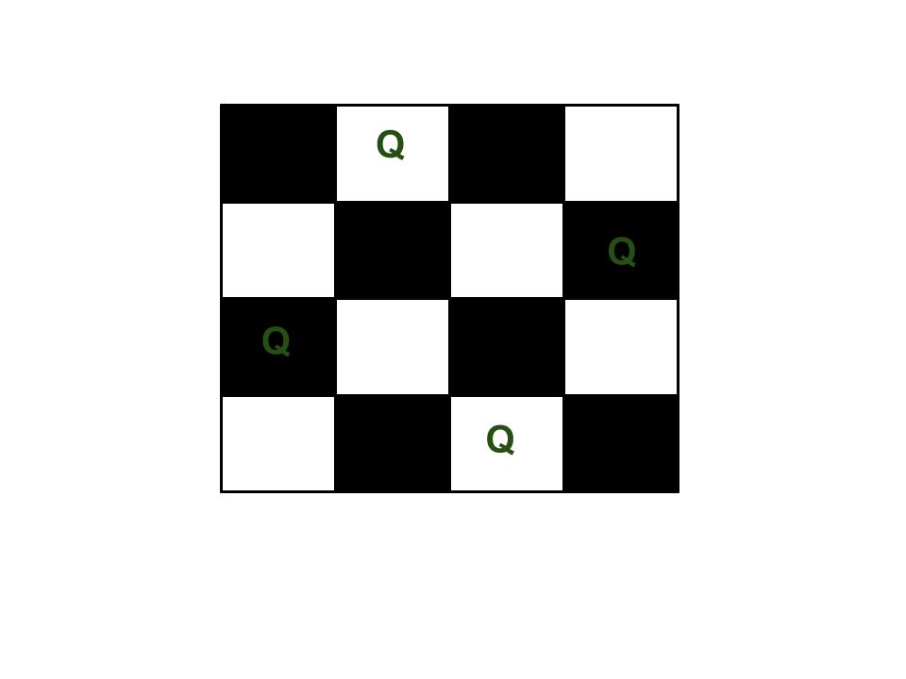
Example: 4-Queen’s Problem
The 4 Queen is the problem of placing 4 chess queens on an 4×4 chessboard so that no two queens attack each other. For example, following is a solution for 4 Queen problem.

Slide 15
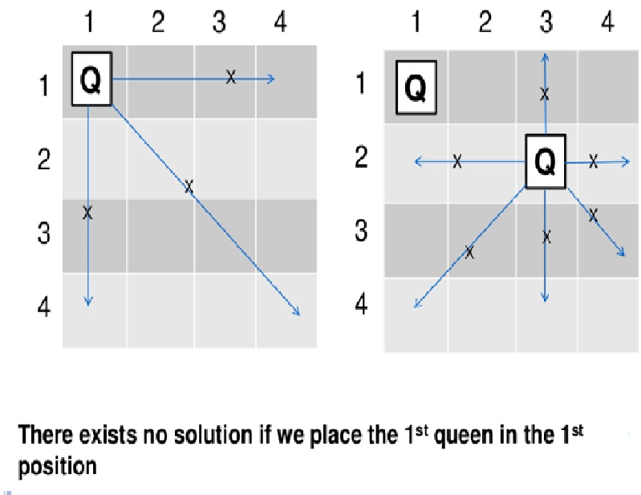
Queen Position
Lets place the first queen in first column and try placing other queens. But this would lead to clash.

Slide 16
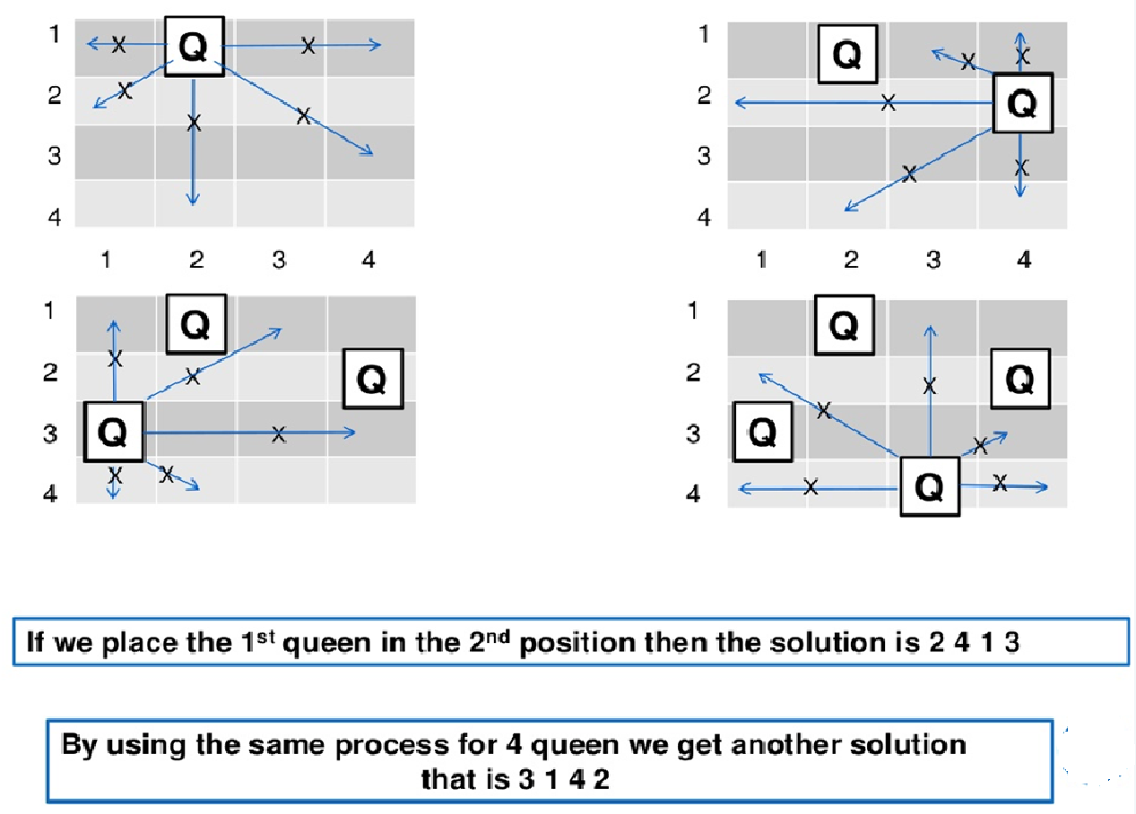
Queen Position
Lets try placing the first queen in second column and try placing other queens. This will give you a solution

Slide 17
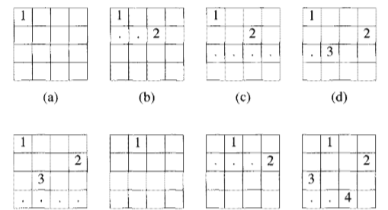
Procedure of N-Queens backtracking
Each recursive call attempts to place a queen in a specific column.
For a given call, the state of the board from previous placements is known (i.e. where are the other queens?)
Current step backtracking: If a placement within the column does not lead to a solution, the queen is removed and moved "down" the column
Previous step backtracking: When all rows in a column have been tried, the call terminates and backtracks to the previous call (in the previous column)
If a queen cannot be placed into column i, do not even try to place one onto column i+1, rather, backtrack to column i-1 and move the queen that had been placed there. Using this approach we can reduce the number of potential solutions even more

Slide 18
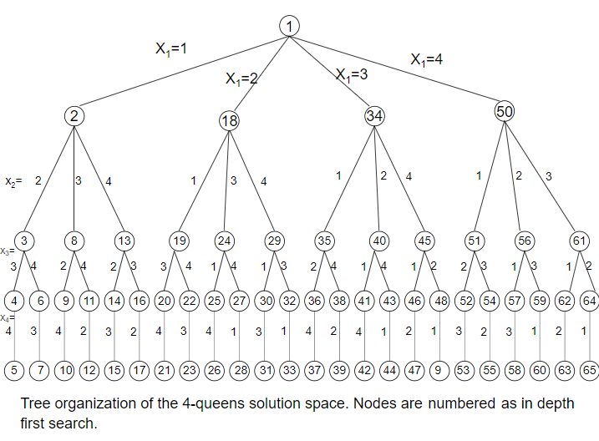
Complete Solution Space of 4 Queens

Slide 19
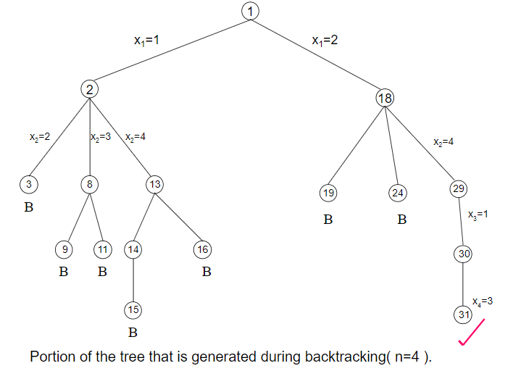
Part of Solution Space of 4 Queens with Bounding functions
‘B’ signifies the bounding functions which says, this path would not be leading to solution.
X1=1 represents placing queen in first column and its branches do not lead to a solution.
X1=2 represents placing queen in second column which leads to one possible solution

Slide 20
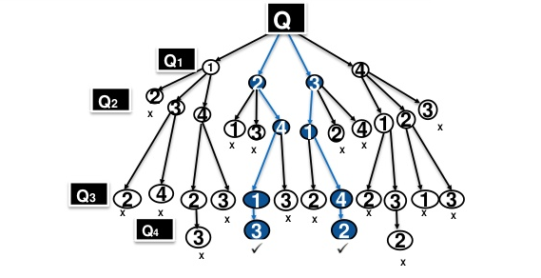
Complete State Space Tree of 4 Queens
A 4 queens problem’s complete state space tree provides only two possible combination of solution

Slide 21
From Implementation Perspective -
How to overcome the column clash and diagonal clash
Column clash:
If a queen is placed in column i, no other queen is placed in the same column
Diagonal clash:
If two queens are placed at positions ( i, j ) and ( k, l ), then they are on the same diagonal only if
i – j = k – l or i + j = k + l
First equation implies
j – l = i – k
Second equation implies j – l = k – I
Therefore, two queens lie on the same diagonal if and only if
j – l = i – k

Slide 22
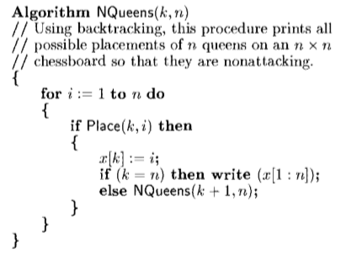
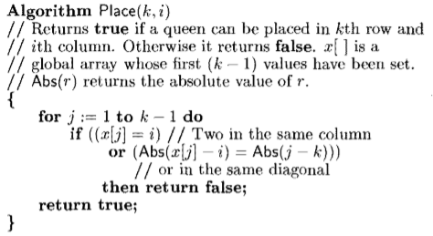
Algorithm

Slide 23
Complexity Analysis – Brute Force
The worst case “brute force” solution for the N-queens puzzle has an O(n^n) time complexity.
This means it will look through every position on an NxN board, N times, for N queens.
It is by far the slowest and most impractical method.
If you refactor and prevent it from checking queens occupying the same row as each other, it will still be brute force, but the possible board states drop from 16,777,216 to a little over 40,000 and has a time complexity of O(n!).

Slide 24
Complexity Analysis – Recursive Backtracking
Backtracking is a recursive method which starts a queen at an edge and, ideally, saves the possible attack positions. Then another queen is placed at a safe position…repeat.
However, if it is found that N number of queens cannot be placed on that board, it will backtrack and try another safe position.
This is over 100 times as fast as brute force and has a time complexity of O(2^n).
Brute force 🡪N^N
Refactored brute force 🡪 N!
Backtracking 🡪 2^N

Slide 25
Thank you

